Slide 1
Lesson fourteen:
Habitat Needs of Rangeland Animals

Slide 2
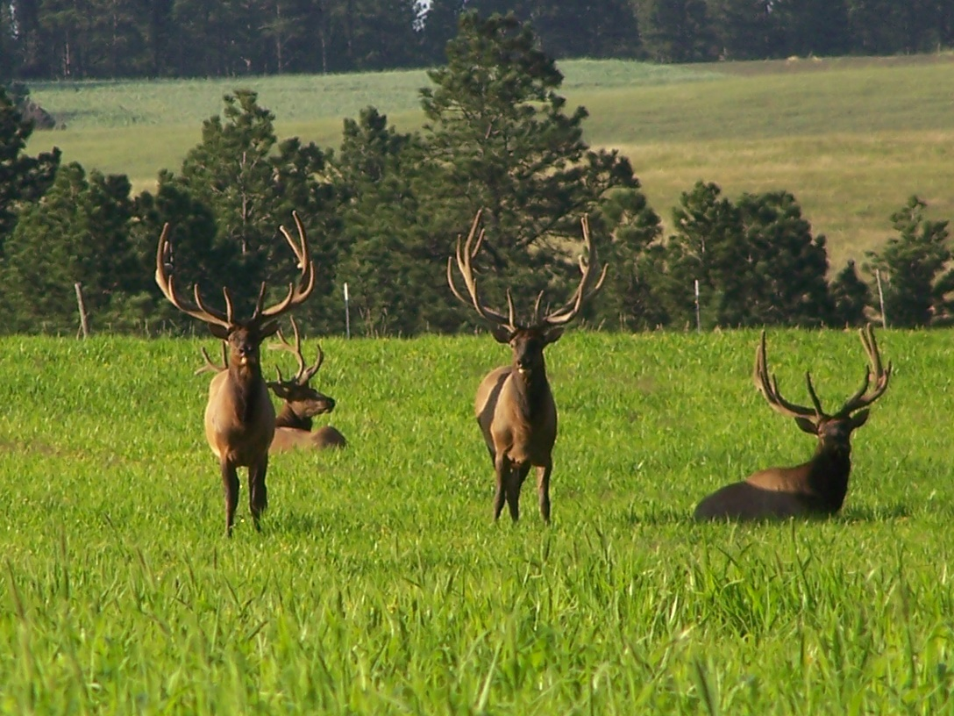
Rangeland Mammals
84% of North American mammals spend at least part of their life in rangeland ecosystems.
Ungulates are large hoofed animals that many people think of when they think of rangeland animals.
Wild ungulates common to North America include bison, pronghorn, elk, and deer.
Domestic ungulates also live on rangeland. Cattle, sheep, goats, and horses are all ungulates.
Many other groups of mammals utilize rangelands. Coyotes, foxes, rabbits and rodents are common rangeland inhabitants.

Slide 3
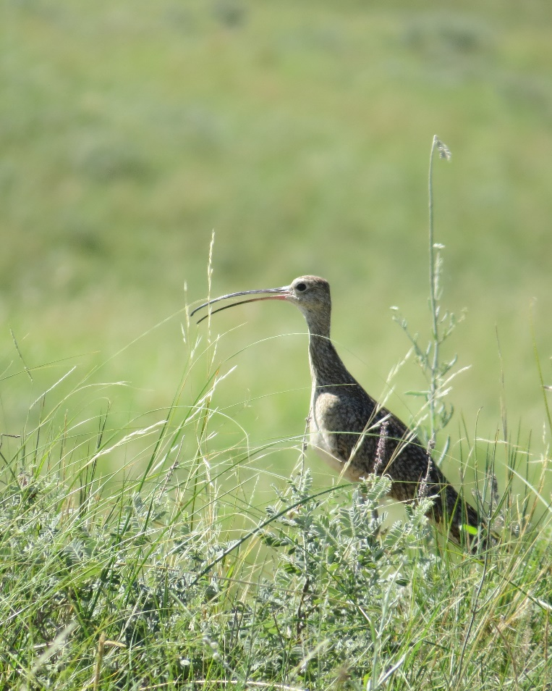
Rangeland Birds
Grassland birds as a group have experienced large declines in populations.
Conversion of rangeland to cropland and encroachment of woody species are two main causes of grassland bird decline.
Grassland birds that have experienced some of the largest declines include upland sandpiper, long-billed curlew, mountain plover, lesser prairie chicken, greater prairie chicken, eastern meadowlark, and Henslow’s sparrow.
Game birds such as grouse, quail, pheasants and turkeys live on rangelands.
Lark buntings, various sparrows, doves and other migratory songbirds call rangelands home.
A variety of hawks and falcons including ferruginous, rough-legged, and red-tailed hawks live in rangeland ecosystems.
Long-billed curlew populations in the western and central Sandhills have declined in recent years.

Slide 4
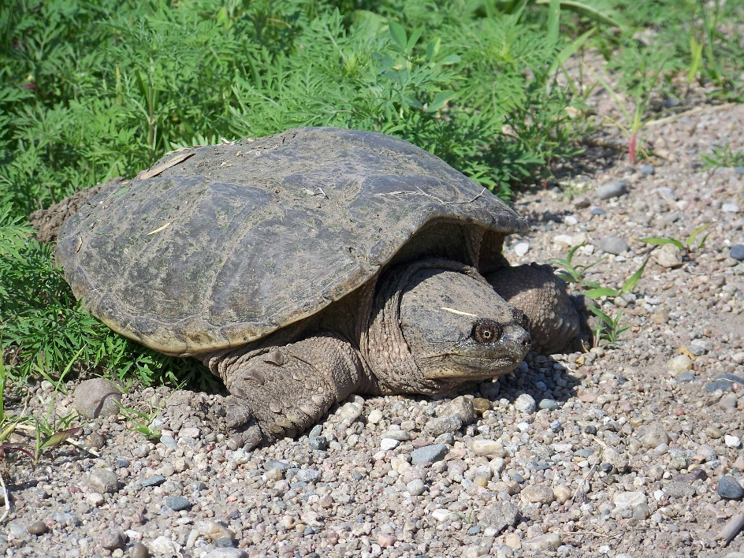
Rangeland Reptiles and Amphibians
A number of frogs, toads, skinks, turtles, and snakes live on rangelands.
Great plains toad, plains spadefoot, Woodhouse’s toad, greater short-horned lizard, bull snakes, western hognose snake, plains garter snake, and prairie rattlesnake are a few of the reptiles and amphibians found on rangelands in the Northern great plains.
Nebraska is home to 14 species of amphibians and 49 reptiles, most of which spend at least part of their life on rangeland.
Blanding’s turtle, barred salamander (tiger salamander), slender glass lizard, and massasauga are of concern in Nebraska.
Snapping turtle, Stanton County.

Slide 5
Rangeland Insects
There are many types of insects present on rangeland. Many of these insects are native but some are introduced.
According to the Nebraska Game and Parks Commission, there are approximately 30,000 species of insects in Nebraska.
Insect groups in Nebraska include moths and butterflies, beetles and true bugs, grasshoppers and crickets, dragonflies and damselflies, ants and bees, flies and many others.
Some insects, like grasshoppers, are regarded by ranchers as pests because they are herbivorous and compete with livestock during droughts when forage production is lower than normal.
Other insects are important in decomposing dead plant material by incorporating it into the soil and improving soil aeration.
Many plants require insects for pollination.
Insects are an important food source for many birds, reptiles and mammals.
The Salt Creek tiger beetle, American burying beetle, monarch butterfly and regal fritillary butterfly are designated as species of conservation interest in Nebraska.
Photo: Monarch butterfly on Pitcher’s or blue sage, Thomas County, NE.

Slide 6
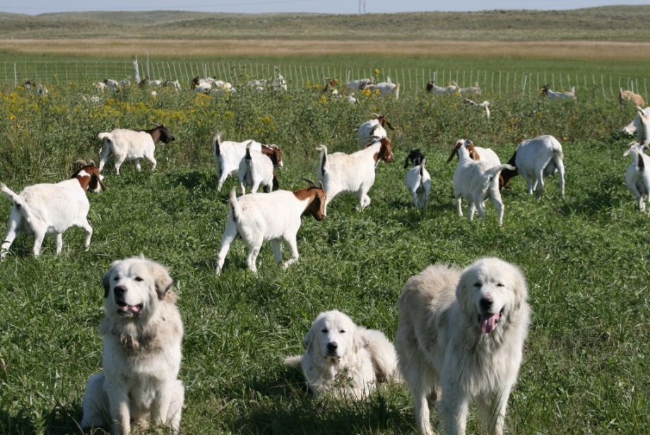
Animal Relationships to Humans
Rangeland animals can be categorized based upon their relationships with humans over time.
Wild animals are wildlife. Their behavior, physiology, and genetics are not largely influenced by humans. There are many types of wildlife that live on rangelands including elk, deer, rabbits, insects, prairie dogs, reptiles and birds.
Domestic animals have been strongly influenced by their relationship with humans. Their behavior, physiology, and genetics have been modified by humans creating new species from their wild ancestors. Domestic animals found on rangelands include cattle, sheep, goats, horses, and honeybees.
Feral animals were once domesticated but have reverted back to a wildlife lifestyle. Wild horses and burros are two common feral animals that inhabit rangelands.
Photo: Domestic goats being guarded by a very common domestic animal – dogs.

Slide 7
Habitat Requirements of Rangeland Animals
Habitat is the home of a species (domestic, wild or feral) and includes all biotic, climatic, topographic and soil factors that affect life.
All animals have four basic habitat needs to survive, thrive and reproduce. Those elements are food, water, cover and space.
The specific combination of those four elements that a species needs is called its niche. Every species that lives on rangelands has a unique niche.
When we manage habitat for a single wildlife species the habitat will improve for that species but will worsen some species.
It is impossible to maximize the habitat quality for all wildlife and domestic animals at the same time in the same area. When managing for many species, trade-offs must be considered. For example, managing for optimum, sustained grass production will have a negative impact on species that require bare ground to thrive.
Photo: Bison grazing, South Dakota.

Slide 8
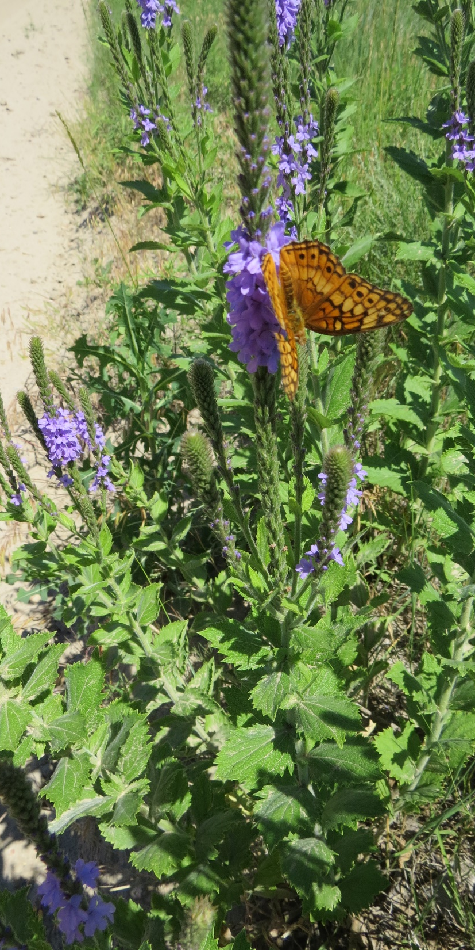
Habitat Requirements: Food
All animals require energy, nutrients and minerals from their food.
Energy comes from starches, sugars, fats and cellulose.
Nutrients come from protein and vitamins
Minerals include phosphorus and potassium as well as trace minerals.
Vegetation type, dietary preferences of animals and spatial arrangement of available food must be evaluated to determine if the food or forage value of rangeland will provide adequate nutrition for wildlife and/or domestic livestock.
Ruminants consume about 2.5% of their body weight per day in terms of weight of air dry forage.
Hind-gut fermenters eat about 3% of their body weight per day in terms of weight of air dry forage.
Concentrate selectors eat about 0.25% of their body weight daily.

Slide 9
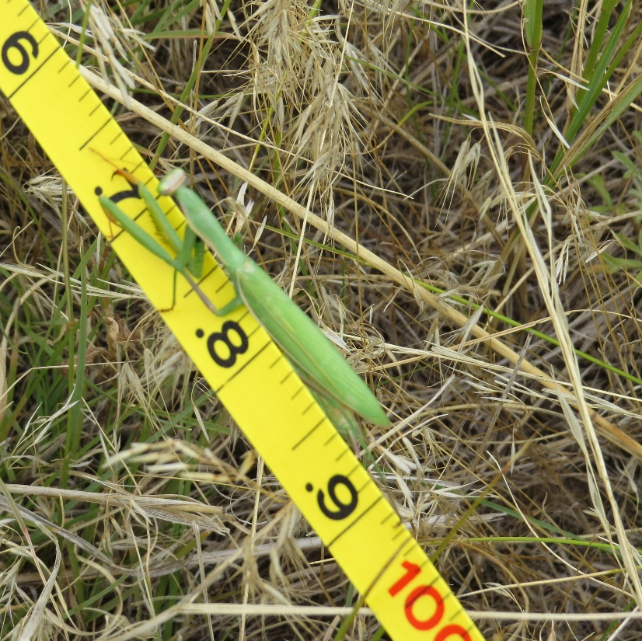
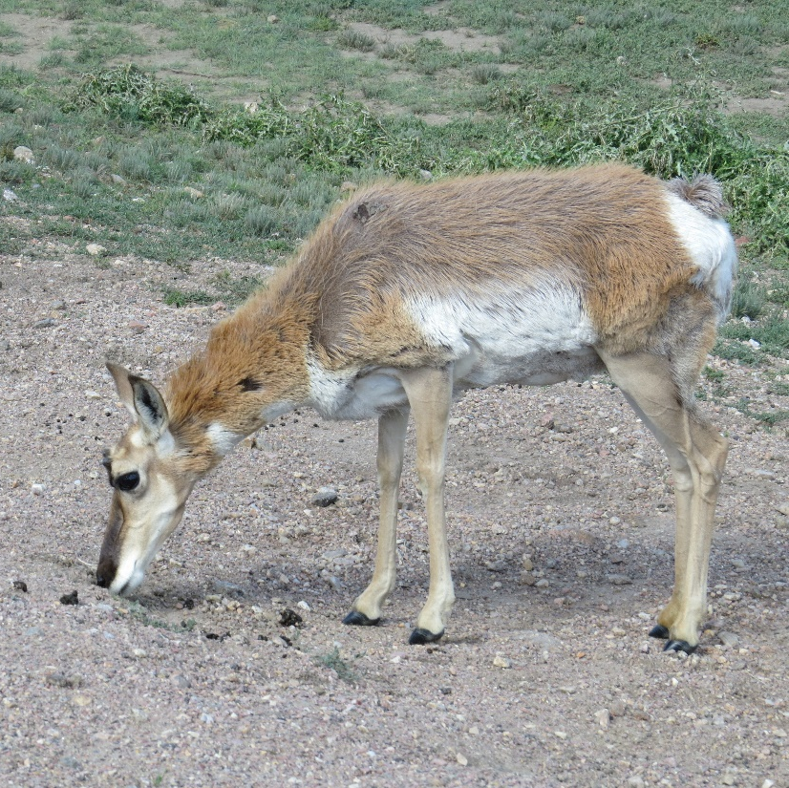
Diet Selection
Rangeland animals can be categorized based upon their diets.
Herbivores are animals that eat only plants.
Grazers eat mostly grasses and include cattle, elk and bison.
Browsers eat some grasses but prefer shrubs. Deer and goats are browsers The leaves and small stems of woody plants are called browse.
Intermediate feeders eat a mixture of grasses, forbs, and shrubs. Diet selection depends upon what is the most nutritious at the time. Sheep and pronghorn eat grasses and forbs in the spring and summer and shrubs in the winter.
Carnivores eat other animals. The diet can include insects, birds, reptiles and/or mammals.
Omnivores eat a diet that includes both animals and plants.
Photos: Top: Praying mantis is a carnivorous insect found in SW Nebraska rangeland, Bottom: Pronghorn, along roadside South Dakota.

Slide 10
How Do Herbivores Digest Plant Materials?
Rangeland herbivores can be categorized based on how they digest plants. Plants have large amounts of cellulose, a carbohydrate that mammals can’t digest.
Most grazing and browsing mammals have a specialized fermentation organ and a symbiotic relationship with bacteria, protozoa and fungi that can break down cellulose into materials that the grazer can use.
Ruminants have a specialized digestive system that includes a rumen that ferments cellulose. Their digestive system includes the rumen, reticulum, omasum and abomasum. Cows, sheep, goats, deer, elk and moose are ruminants.
Hind-gut fermenters have an enlarged cecum or colon, which is located past the stomach, where microbes that ferment forage live. The microbes release energy that can be used by the grazing animal. Rodents, rabbits and horses are hind-gut fermenters.
Concentrate-selectors can’t digest fiber (cellulose) so they forage on berries, seeds, and roots because they are low in cellulose. Birds, mice, and bears select plant parts that are low in cellulose.

Slide 11
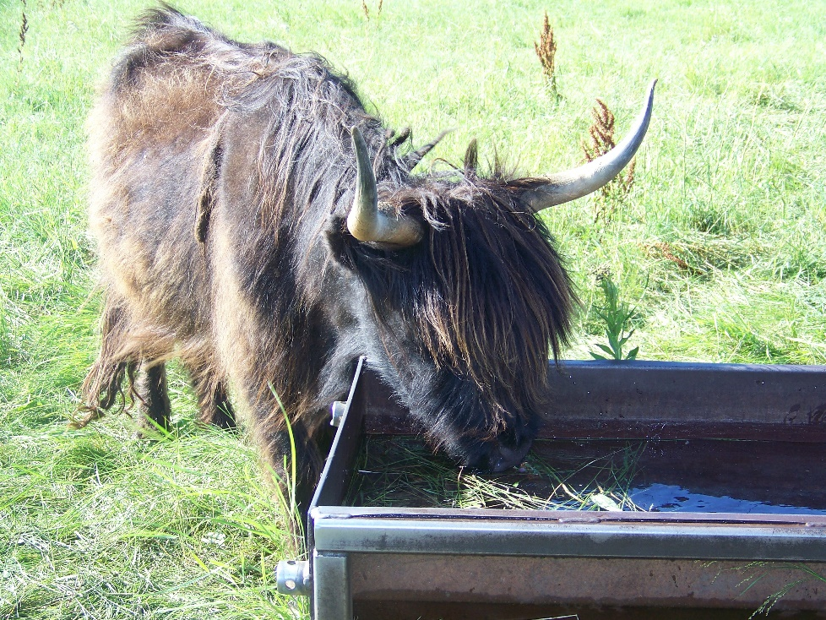
Habitat Requirements: Water
Water requirements vary depending upon the animal species and weather conditions. See Lesson 16 for water requirements of various rangeland animals.
Some rangeland wildlife, especially those in arid and semi-arid areas, can meet most of their water requirement from forage, dew or as a byproduct of their body breaking down fat and starches.
Turkey vultures, kangaroo rats, javelina, bighorn sheep roadrunners and rattlesnakes are some of the animals that obtain much of their water from their food.
Plants can contain a significant amount of water. For example, young grasses may be up to 75% water.

Slide 12
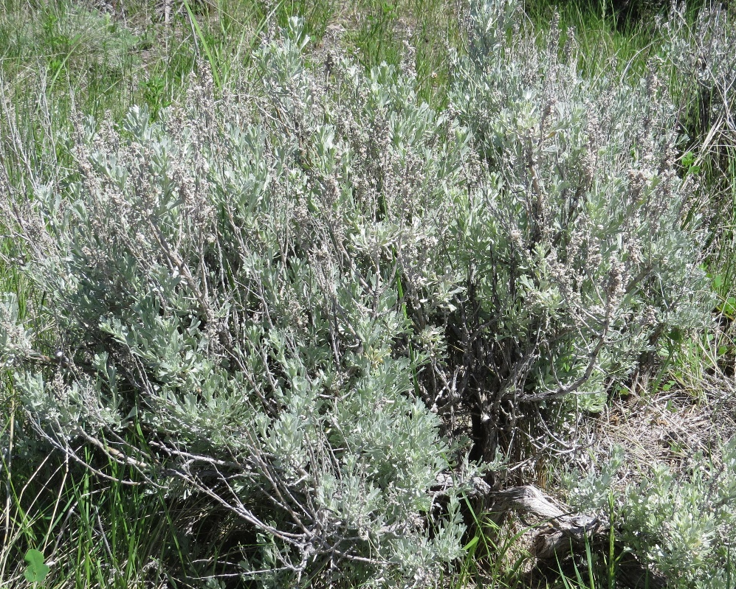
Habitat Requirements: Cover
Cover is shelter from weather conditions and predators.
Plants provide thermal protection in the summer by providing shade and in the winter by providing shelter from wind and cold.
In many ecosystems shrubs and trees provide thermal cover, but in grasslands, grasses and forbs can provide cover for many wildlife species.
Animals hide under large plants for protection by visual obstruction.
Other animals are protected from predators by lack of visual obstruction. These animals (pronghorn and prairie dogs for example) prefer open areas where they can see predators and escape by running away or going underground.
Photo: Sagebrush, such as this Wyoming big sagebrush, is used for visual obstruction by many wildlife species on western rangelands.

Slide 13
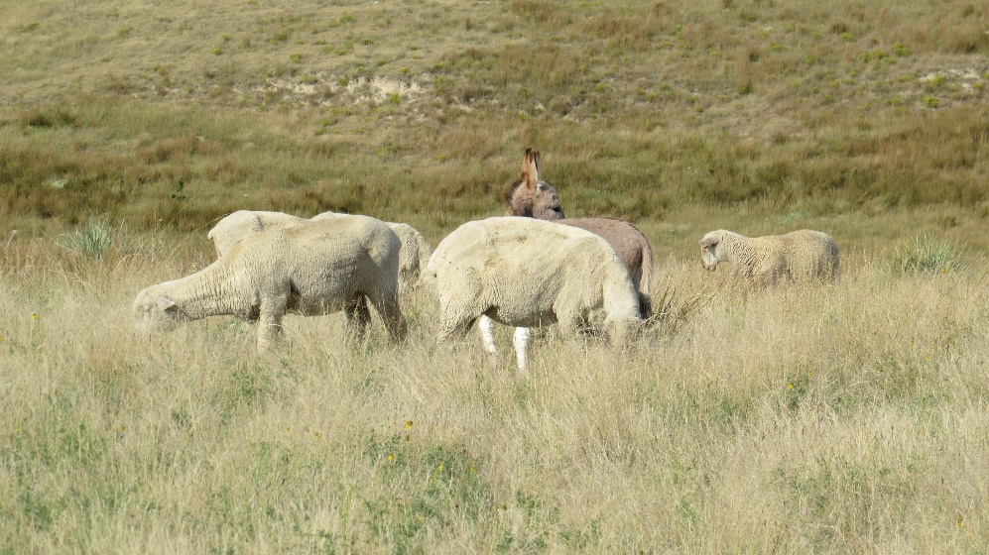
Habitat Requirements: Space
Adequate space is a consideration for breeding and nesting, home range, social interactions, and disease prevention.
Home range is the area in which an individual animal conducts its normal daily and annual activities.
The area can be shared with members of its own species or with other species.
The extent of a home range is directly related to the animal’s size and dietary preference. Larger animals usually have a larger home range and carnivores have very large home ranges when compared to herbivores.
Photo: Sheep with guard donkey. Sheep have a smaller space requirement than cattle.

Slide 14
Rangeland Animal Interactions
Livestock and wildlife occupy the same area of rangeland. The interactions among them can be somewhat or mostly harmful, somewhat or mostly beneficial, or have no impact on either.
The relationships may be:
Mutualism
Commensalism
Antagonism
Amensalism,
Competition or
Neutralism.

Slide 15
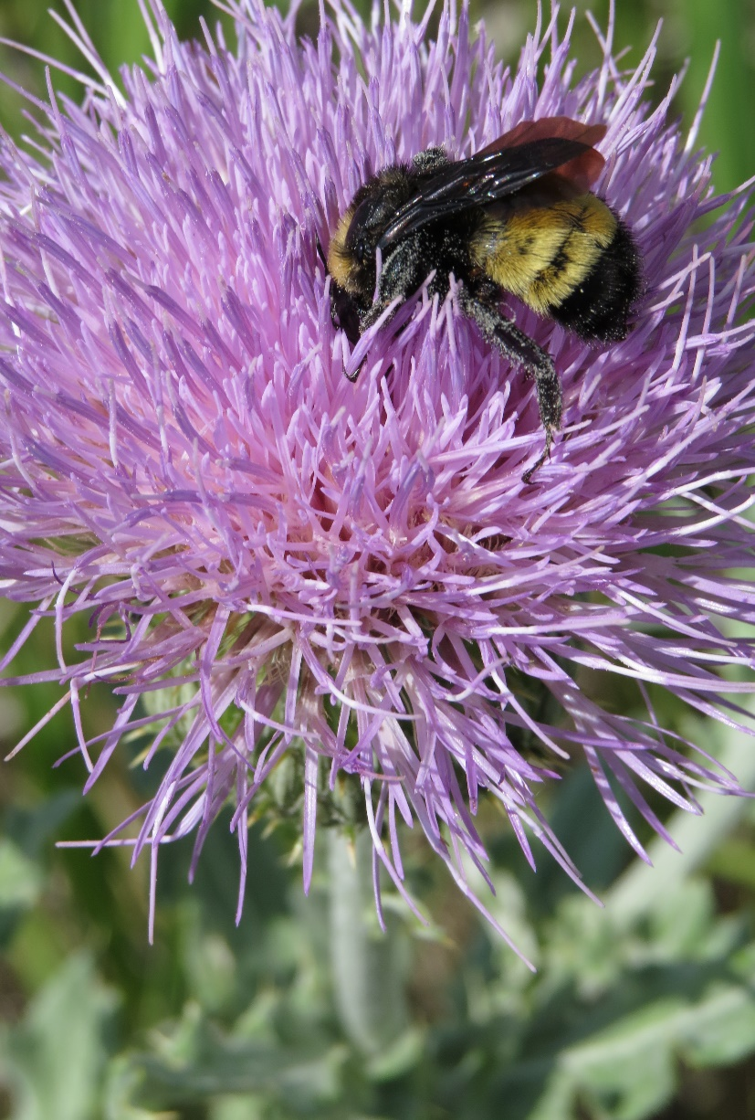
Rangeland Animal Interactions
Mutualism: A relationship between two animals in which both benefit from the association.
Cattle egrets are a bird that often perch on the backs of cattle or bison and eat ticks, insects and grubs. The insects are a food source for the birds and the birds benefit the cows and bison by getting rid of insect pests.
Bees visit rangeland flowers such as this Wavyleaf thistle flower. The flower supplies food (nectar) to the bee and the bee benefits the plant by pollinating the flower.

Slide 16
Rangeland Animal Interactions
Commensalism: A relationship between two individuals in which one derives some benefit and the other is unaffected.
Dung beetles eat manure from ruminant animals like cows or elk. The dung is a food source for the beetles (a benefit) but the beetle’s activity does not effect the cows or elk.
Burrowing owls live in prairie dog burrows. The prairie dogs provide habitat (shelter) to the burrowing owls, but burrowing owls don’t affect the prairie dogs.

Slide 17
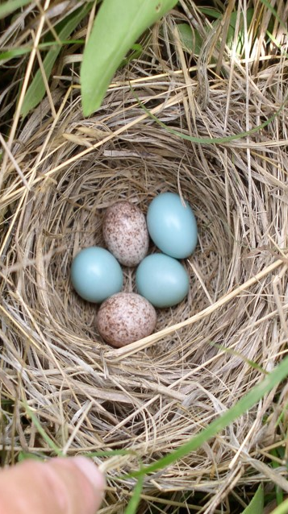
Rangeland Animal Interactions
Antagonism: A relationship in which one species benefits at the expense of another. This includes predation and parasitism.
When a coyote eats a rabbit or lamb, the coyote gets the benefit of a food source, but the rabbit or lamb is harmed (killed).
Brown headed cowbirds are common grassland birds that are nest parasites. They lay eggs in nests of other bird species. The cowbird’s chick grows faster and receives more food to the detriment of the host bird’s chicks.
Photo: Blue eggs are robin eggs the brown spotted eggs are brown headed cowbird eggs.

Slide 18
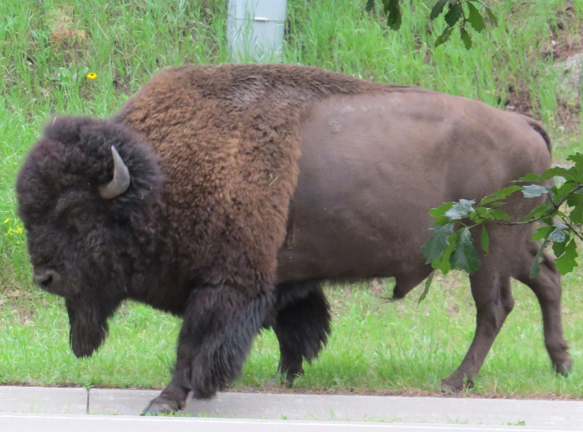
Rangeland Animal Interactions
Amensalism: A relationship between two animals in which one is adversely affected and the other is unaffected by being associated with the first animal.
Bison can carry a bacterial disease called brucellosis. The bison have no apparent symptoms. When infected bison interact with cattle they can infect the cattle.

Slide 19
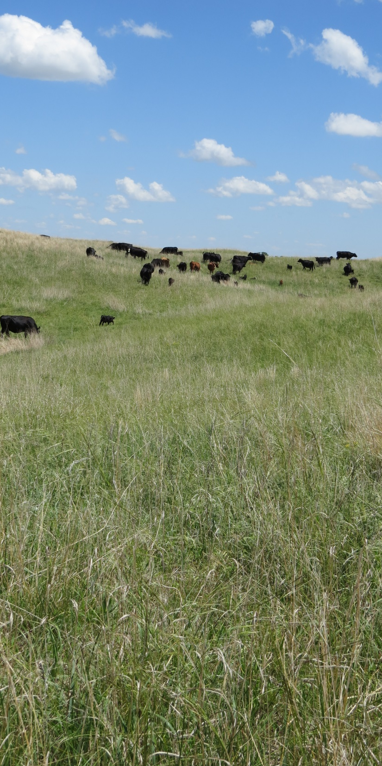
Rangeland Animal Interactions
Competition: A relationship between two animals that use the same resource (food, water, etc.) that is in short supply. Both animals will be harmed because neither will have enough to meet their requirements.
Elk and cattle may be eating the same forage. If that forage is in short supply, both animals will be harmed.
If there is abundant supply of the resource, then the animals are not in competition.

Slide 20
Rangeland Animal Interactions
Neutralism: A relationship between two species that interact or share the same habitat but do not affect each other.
Meadowlarks and blue birds live on rangelands with cattle. They do not have an effect on cattle and cattle do not have an effect on them.
Rabbits, deer and frogs live on together on rangelands but have no effect on one another.

Slide 21
Livestock and Wildlife Interactions
Livestock grazing can positively or negatively impact wildlife that live on rangelands.
Livestock management can be used in a way to improve wildlife habitat. Livestock managers can use time, frequency and/or intensity of grazing, and type of livestock to achieve wildlife habitat goals. Rangeland that is ungrazed will have a different plant community than grazed rangeland.
Livestock grazing can damage wildlife habitat values if grazing management plans do not consider wildlife habitat. Reduced cover, parasite/disease transmission, changes in plant communities are some potential negative impacts of livestock and wildlife interaction. Fences and roads can be detrimental to some species of wildlife.
Well thought out grazing management strategies that account for wildlife will limit negative interactions, enhance habitat quality for domestic and wild animals and promote complementary relationships between wildlife and domestic livestock.

Slide 22
Activities and References
Activities
References
Identify the primary wildlife species in your area or in the area of the State competition. Determine the types of relationships among the most common wildlife species and livestock.
Grassland Birds, NRCS Wildlife Habitat Management Institute
Management of Sandhills Rangeland for Greater Prairie Chicken
Habitat Requirements of Wildlife: Food, Water, Cover and Space

Slide 23
End of Lesson Fourteen

